Slide 1



Department of Electronics and Communication Engineering Final Review Heat Sink Integrated X-Band Antenna (05/04/2024)
Team members:
Nathan S - 927621BEC132
Pavithran A V - 927621BEC145
Raguladhithiya S - 927621BEC160
Rakesh C - 927621BEC161
Guided by:
Mr.T.Senthil Kumar.,
A/P, ECE.

Slide 2
Introduction:
This study explores integrating a heat sink into an X-band antenna to manage thermal challenges. High power densities in X-band antennas often lead to performance degradation. By dissipating heat effectively, the integrated heat sink maintains optimal operating temperatures, ensuring reliability. Computational simulations and experiments validate improved thermal performance without compromising electromagnetic characteristics. This approach offers a promising solution for enhancing reliability and performance in X-band antenna systems used in radar, communication, and sensing applications.
Microstrip Patch Antenna

Slide 3

Problem Identification :
The increasing demand for compact and efficient X-band antennas poses significant thermal management challenges due to high power densities. Traditional designs suffer from performance degradation and potential hardware failure due to inadequate heat dissipation. Addressing these issues is critical for ensuring long-term reliability and optimal performance of X-band antenna systems. Therefore, there is a pressing need to develop innovative solutions for integrating heat sinks into X-band antennas to effectively manage thermal dissipation while maintaining electromagnetic performance.

Slide 4
Objective :
To design an Microstrip Patch Antenna in the X-Band frequency.
Implementation of heat sink by integrating it with the Microstrip patch antenna.

Slide 5
Existing methods:
Current methods for thermal management in X-band antennas primarily rely on passive heat dissipation techniques such as heat sinks, thermal pads, and metal enclosures. Heat sinks, often made of aluminum or copper, are attached to high-power components or directly to the antenna structure to facilitate heat transfer through conduction and convection. Additionally, thermal pads are used to improve contact between components and heat sinks, enhancing heat dissipation efficiency. Metal enclosures provide further thermal insulation and protection, reducing the impact of external temperature fluctuations. However, these methods have limitations in effectively managing heat in compact antenna designs with high power densities, often resulting in thermal inefficiencies and performance degradation over time. Thus, there is a need for more innovative and integrated approaches to enhance thermal management in X-band antenna systems.

Slide 6
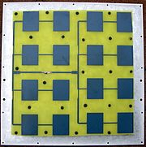
Design Specifications:
Substrate Material - FR4 epoxy
Dielectric Constant - 4.4
Impedance - 50 ohm
Substrate Thickness - 4 mm
Antenna width - 9.12 mm
Operating Frequency - 10 GHz
Gain - 6.8 dB
Microstrip Patch Antenna

Slide 7
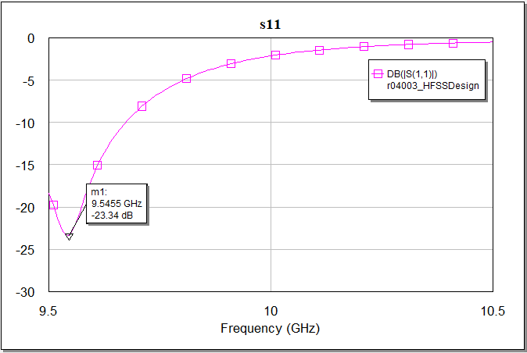
Results :

Slide 8
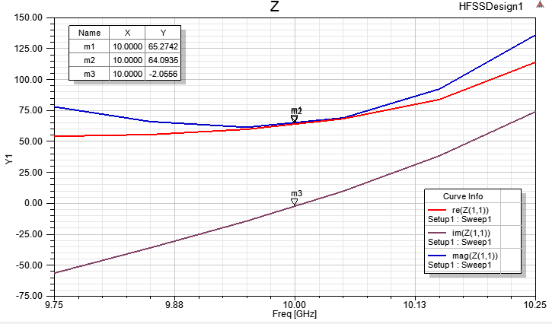
Impedence :

Slide 9
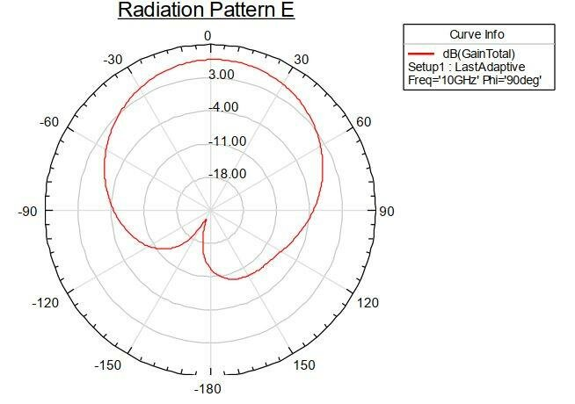
Radiation Pattern :

Slide 10


